Slide 1



Insurance Claims
View in Power BI
Last data refresh:
2023/09/07 02:58:08 UTC
Downloaded at:
2023/09/07 04:15:21 UTC

Slide 2
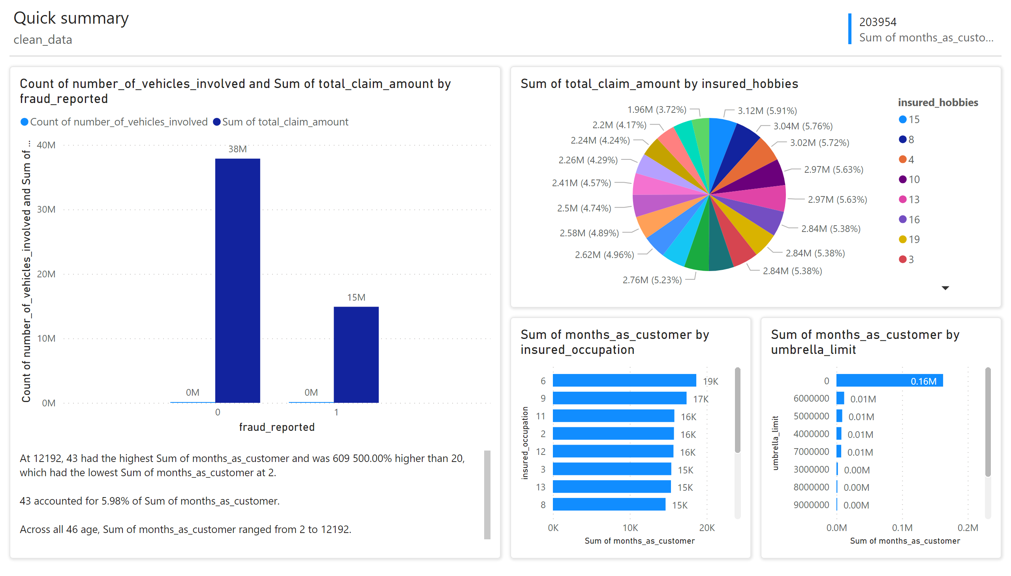
Page 1
Notes:
clusteredColumnChart
No alt text provided
pieChart
No alt text provided
clusteredBarChart
No alt text provided
clusteredBarChart
No alt text provided
shape
No alt text provided
textbox
No alt text provided
shape
No alt text provided
shape
No alt text provided
shape
No alt text provided
textbox
No alt text provided
textbox
No alt text provided
multiRowCard
No alt text provided
shape
No alt text provided

Slide 3
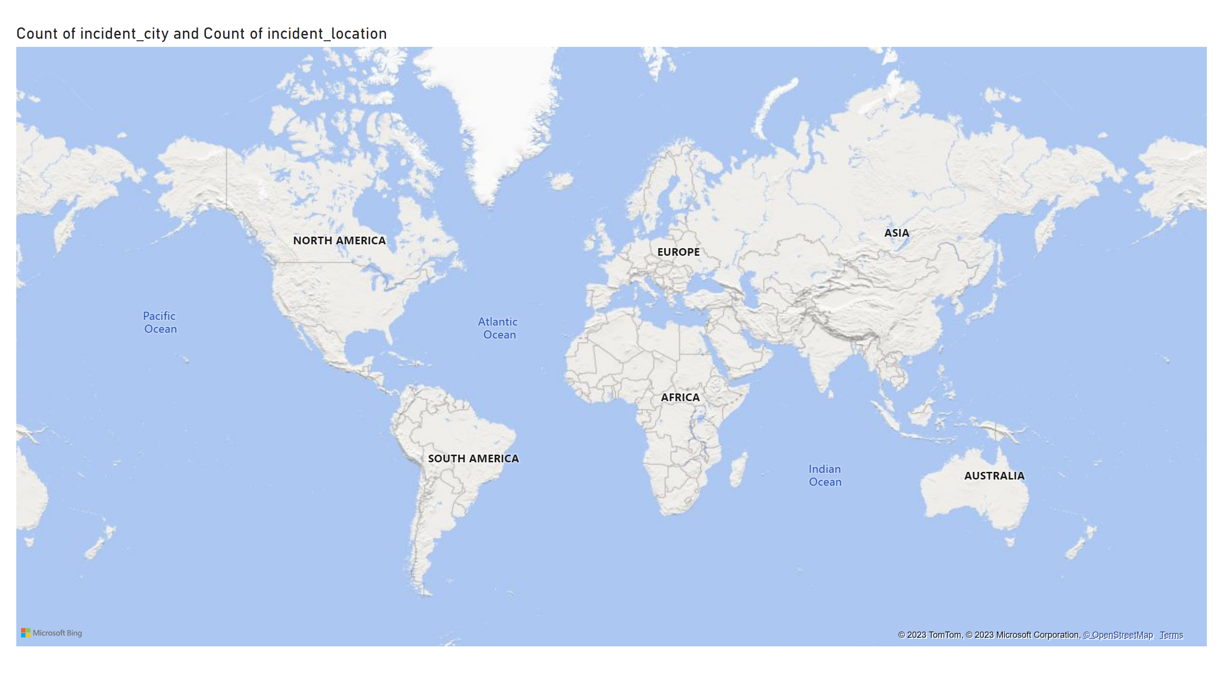
Page 2
Notes:
textbox
No alt text provided
map
No alt text provided

Slide 4
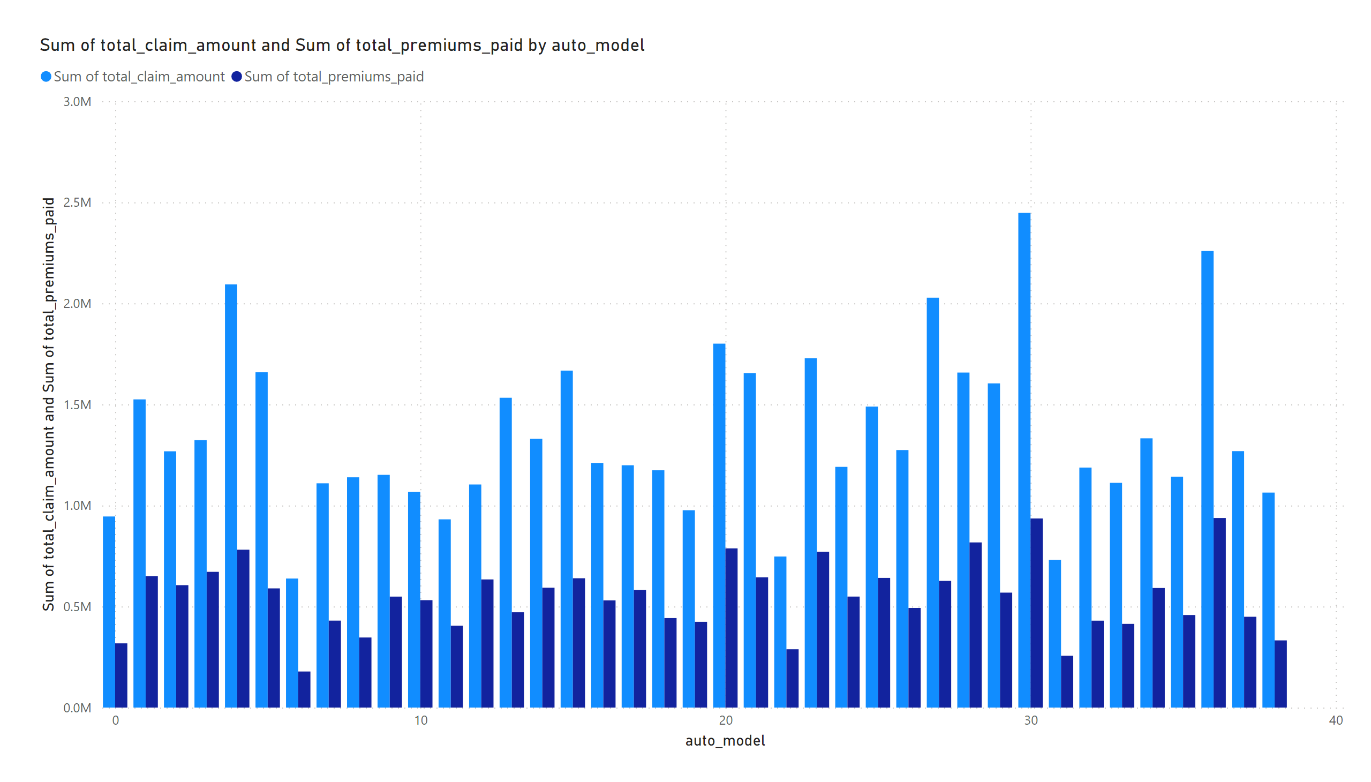
Page 3
Notes:
clusteredColumnChart
No alt text provided

Slide 5
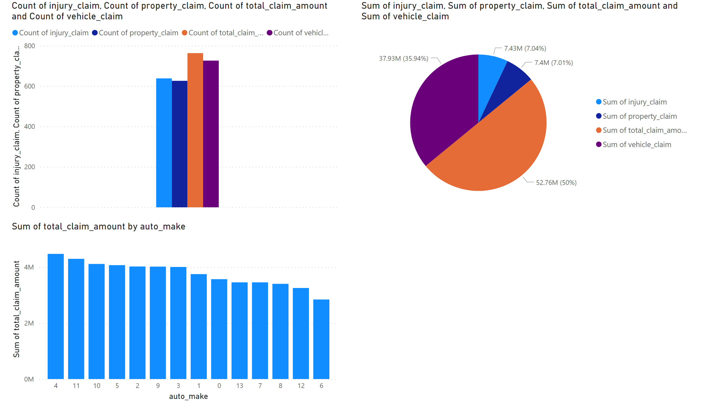
Page 4
Notes:
textbox
No alt text provided
clusteredColumnChart
No alt text provided
pieChart
No alt text provided
clusteredColumnChart
No alt text provided

